Slide 1
Multi-trait polygenic score generation workflow
A generalized workflow to generate polygenic risk for multiple traits
Notes:
Work in progress
Would love Opinions!
Rick A. Reijnders¹, Ghazi Al Jowf, Ehsan Pishva, (Utrecht team), Laurence de Nijs, Lars M.T. Eijssen, Bart P.F. Rutten
¹ Department of Psychiatry and Neuropsychology, School for Mental Health and Neuroscience (MHeNS), Maastricht University, Maastricht, The Netherlands
² Department of Bioinformatics—BiGCaT, Maastricht University, PO Box 616, 6200 MD Maastricht, The Netherlands

Slide 2
The situation
Start coding
In linux
In windows bash
Find every parameter
Make it work
Results a scattered script / worflow dedicated to your research question and ‘might’ be ported to other data

Slide 3
The idea
Calculate PGS models
Generate PGS scores
Standardized workflow
Easy to use for us, internally
Preferred in R

Slide 4
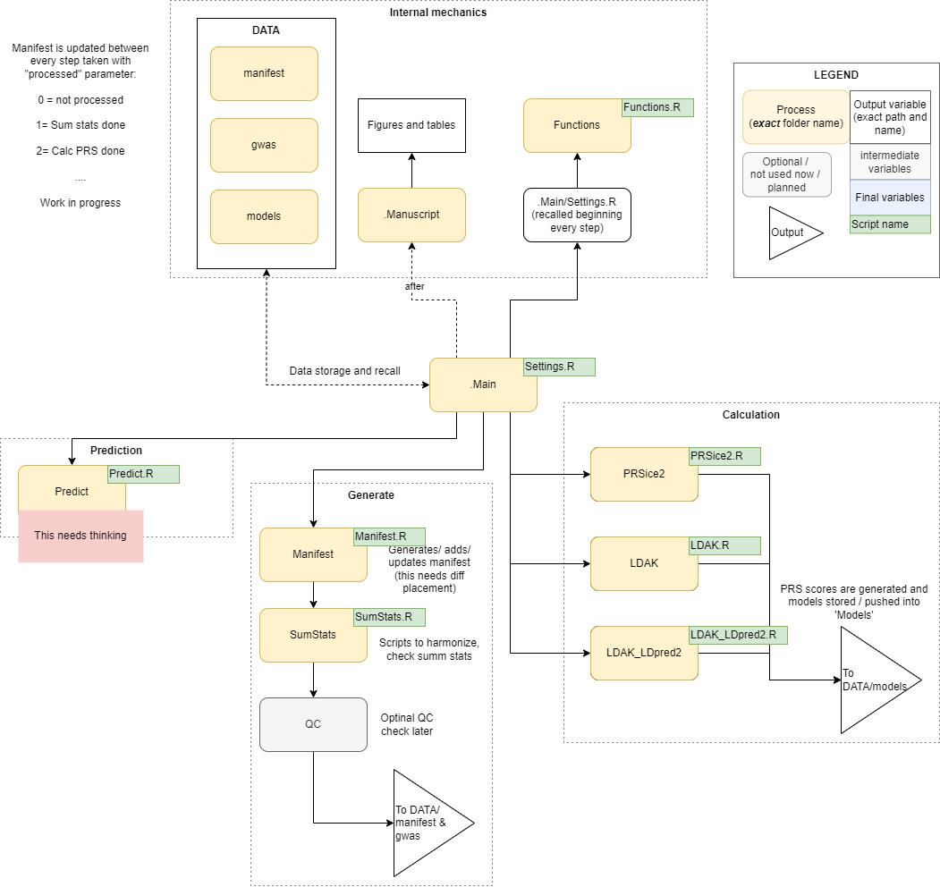
The workflow
Workflow
Get GWAS (Generate)
Make PGS model (Calculation)
Store models (Internal)
Generate PGS scores (Prediction)

Slide 5
The workflow
Workflow
Get GWAS (Generate)
Make PGS model (Calculation)
Store models (Internal)
Generate PGS scores (Prediction)

Slide 6
The workflow
Workflow
Get GWAS (Generate)
Make PGS model (Calculation)
Store models (Internal)
Generate PGS scores (Prediction)

Slide 7
The workflow
Workflow
Get GWAS (Generate)
Make PGS model (Calculation)
Store models (Internal)
Generate PGS scores (Prediction)

Slide 8
The workflow
Workflow
Get GWAS (Generate)
Make PGS model (Calculation)
Store models (Internal)
Generate PGS scores (Prediction)

Slide 9
Current status
All in R
Multiple basic GWAS examples running
Need time to connect objects
(object output to object input)
Needs standardized GWAS input
Then evaluate and plot further course

Slide 10
Last time
Generate PGS scores on ADNI
Educational Attainment (2022)
AD (Lambert, 2013; IGAP)
AD (Janssen, 2019; PGC-ALZ, IGAP, ADSP)
Dive deeper in specific / current PRS models and settings
Option for ancestry filter
Multiclass PGS

Slide 11
Todo
Time to fix and patch code
Multitrait mode (generate multiple trait PGSes)
Option for ancestry filter
Harmonization GWAS SumStat / QC
Sharing workflow to other computers
Multiclass PGS
Detailed understanding of PGS algorithms
MegaPRS to start
Dive deeper in specific / current PRS models and settings
The actual tasks for answering the RQ

Slide 12
Good to know
Calculation specs for now roughly:
600k SNPs 6 min …
800k SNPs 11 min ~11 GB + 3
1.1M SNPs 14 min ~15 GB (cor) + 5 GB (ana)

Slide 13
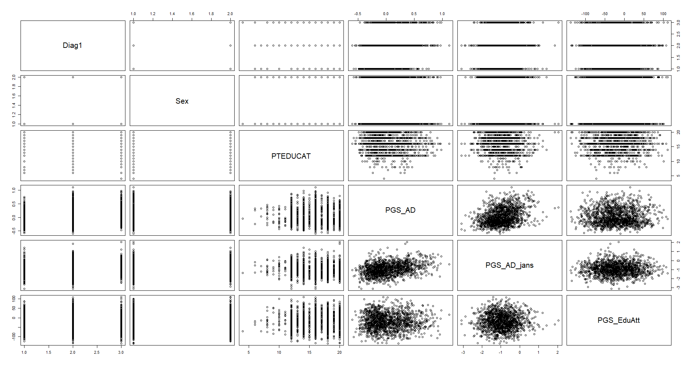
ADNI

Slide 14
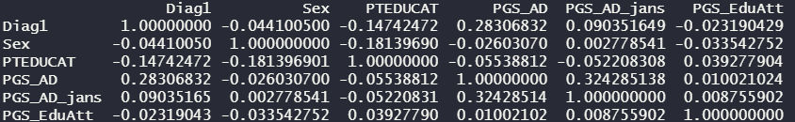
ADNI

